Slide 1

Analysis-Personal Protection Insurance (PPI)
By- NAMRATA NANDY

Slide 2
Business Problem
A consumer bank with a range of products would like to cross-sell insurance to its consumer base (that is, cross-sell the personal protection insurance (PPI) product to those customers who have a secured or unsecured type of loan, but no PPI product as yet).

Slide 3
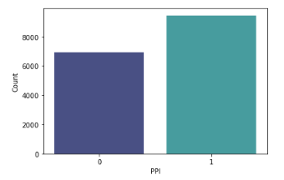
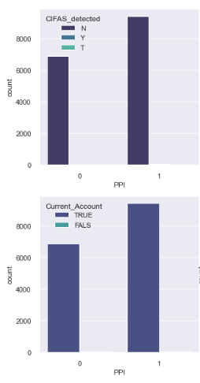
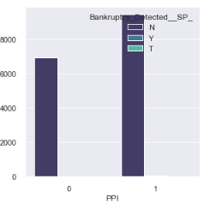
Exploratory Data Analysis
58 variables
Int64- 34
Object- 21
Float64- 3
* Bankruptcy indicator- Negligible customers have bankruptcy indicator.
* Current Account- All customers have current account.
* CIFAS Detected- Negligible customers are detected with fraud by CIFAS.

Slide 4
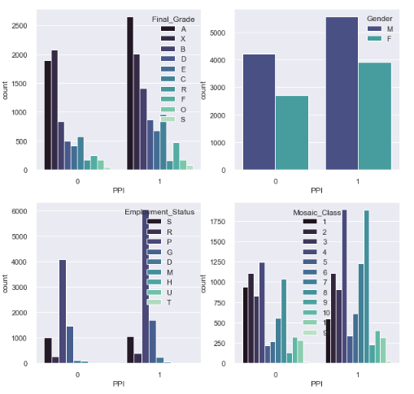
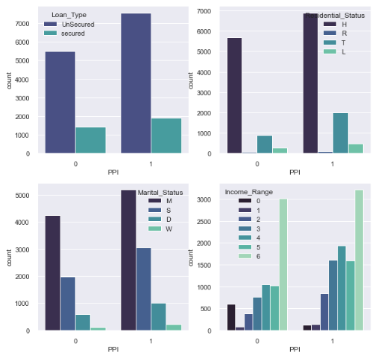
* Male customers are more tend to buy insurance compared to females.
* Final_grade and Credit_score have a relation with grading assigned to customer based on their credit score. Grade “A”, “B” are more likely offered PPI.
* Low- Income Range customers are less likely to opt for PPI. Medium-High Income Range customers are more likely to have PPI.
Mosaic is a cross-channel consumer classification system designed by Experian which segments customer population into certain groups to understand an individual's likely customer behaviour- Source

Slide 5
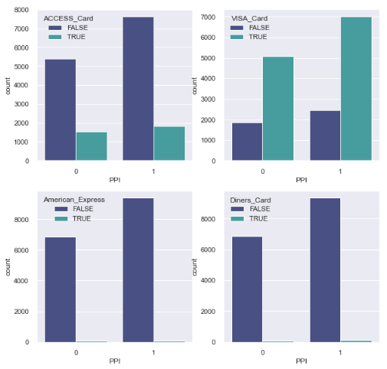
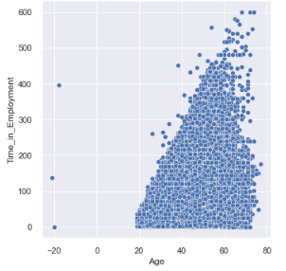
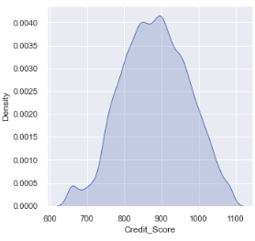
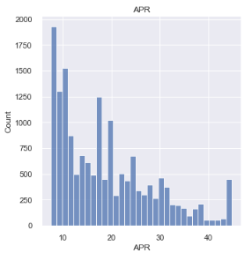
* Age and time_in_employment- With age increasing, time in employment increases. Certain population fall in retirement bucket with age on higher side and no time in employment.
* Majority customers lie in 800-1000 credit score.

Slide 6
Correlation(Spearman)-Target
Correlation with target was checked as an initial step to find out important features.

Slide 7
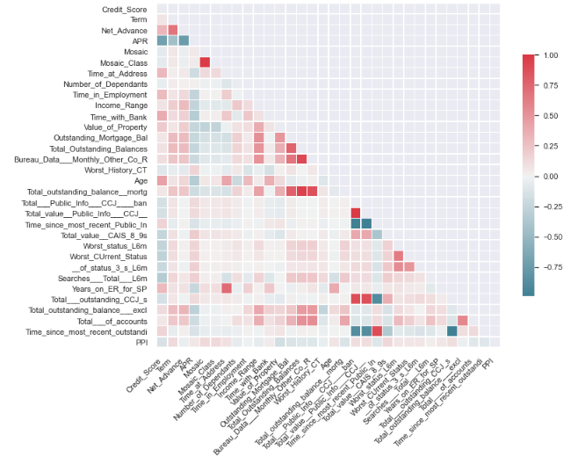
Correlation(Spearman)-X*X across independent variables
Features were analysed to find if there is any high correlation between them.
Eliminated | Retained
Mosaic | Mosiac_Class
Time_since_most_recent_outstandi | Total___Public_Info___CCJ____ban
Total___outstanding_CCJ_s
Time_since_most_recent_Public_In
Total_value__Public_Info___CCJ__
Total_Outstanding_Balances | Outstanding_Mortgage_Bal
Bureau_Data___Monthly_Other_Co_R
Total_outstanding_balance__mortg

Slide 8
XGBoost Model
learning_rate: How much the weights are adjusted each time a tree is built.
colsample_bytree: subsample ratio of columns when constructing each tree.
max_depth : Maximum depth of a tree.
xgb_model = XGBClassifier(colsample_bytree=0.8,
learning_rate=0.05,
max_depth=4,
min_child_weight=4,
n_estimators=500,
nthread=4,
objective='binary:logistic’,
seed=143,
silent=1,
subsample=0.8)
min_child_weight: Minimum sum of instance weight (hessian) needed in a child.
seed: Random number seed.
subsample: Subsample ratio of the training instances.
Objective: learning objective.
Fun Fact: Given the high event rate and weak correlation with the target, 57% accuracy can be achieved if we mark all the customers as 1.
silent: Silent mode is activated is set to 1, i.e. no running messages will be printed.
nthread: Number of parallel threads used to run XGBoost. .
n_estimators: Number of gradient boosted trees. Equivalent to number of boosting rounds.

Slide 9
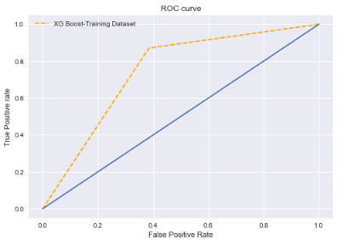
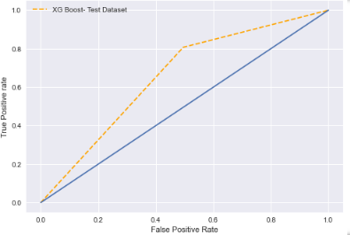

Performance Indicators
Data
Train
80%
Test
20%
Stratified
Training Dataset
Model Predicted | PPI | 0 | 1
 | 0.00 | 3405 | 2132
 | 1.00 | 977 | 6592
AUC | 0.74
Accuracy | 76.28
Testing Dataset
Model Predicted | PPI | 0 | 1
 | 0.00 | 699 | 686
 | 1.00 | 365 | 1527
AUC | 0.66
Accuracy | 67.93

Slide 10
Feature Importance

Slide 11
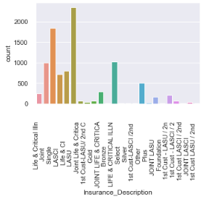
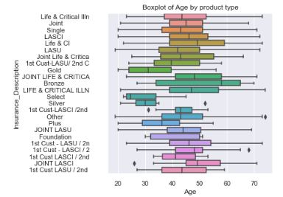
Insurance-Wise Distribution
* Marketing & Advertisements must be focused on Single,LASU and Joint PPI Products.
*Customers with age 40-60 must be targeted with Single,LASU and Joint PPI Products. *Customers with age <35 must be offered Select and Silver Plans.

